Slide 1
Lecture-5
Chapter-4
Computer Architecture and Organization- Jhon P. Hayes
Datapath Design

Slide 2
Datapath Design
This lecture will addresses the register-level design of the datapath (data processing unit).
Fixed-Point Arithmetic:
The design of circuits to implement the four basic arithmetic instructions for fixed-point numbers- addition, subtraction, multiplication and division.

Slide 3
Multiplication
Combinational Multiplier
  Typically uses an array of CSA (carry save adder) modules
  Trades off space (hardware) for time (calculation speed)
Sequential Multiplier
  Executes a sequence of add-and-shift operations
  Tries to minimize number of add-and-shifts required
  Advantage: can use existing registers and ALU
  Disadvantage: slower than combinational version

Slide 4
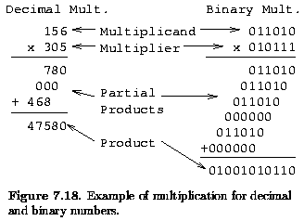
Multiplication H/W
Based on paper-and-pencil method of repeated shift-and-add operations

Slide 5
Observations
Multiplication of single digits in binary multiplication is just an “AND” operation
Multiplication of two n-bit numbers can be accomplished with (n-1) additions
Can use array of AND gates, HA’s, and FA’s
  Figs. 4.17, 4.18, 4.19 (pp. 242-243) --> CSA
Question: Where is most of the “delay” in this design?
(Jump)

Slide 6
Division
Sequential Divider
  Executes a sequence of subtract-and-shift operations
  Tries to minimize number of add-and-shifts required
  Advantage: can use existing registers and ALU
  Disadvantage: slower than combinational version
Combinational Divider
  Uses an array of 1-bit subtracter modules
  Trades off space (hardware) for time (calculation speed)

Slide 7
Sequential Division H/W
Based on paper-and-pencil method of repeated subtract operations
  Note: quotient bit needs to be “guessed”)
Two basic methods available
  Restoring division
    restore partial remainder if guess is wrong
  Nonrestoring division
    change next subtract step to addition if guess is wrong
More advanced methods based on other guessing (deduction) methods

Slide 8
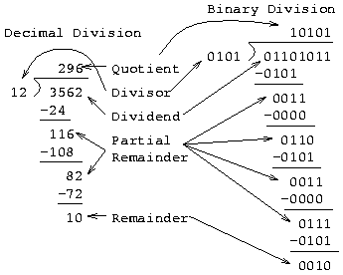
Paper-and-pencil Division Method

Slide 9
Arithmetic Logic Unit (ALU)
Uses of the ALU
  process arithmetic and logical instructions
  address calculations
  act as a data conduit (route data between two points)
ALU Design Techniques
  many advanced transistor-level design techniques used to achieve fast ALU designs
  gate-level designs can be “flattened” for better performance
  basic ALU design is fairly simple

Slide 10
Design of One Bit of ALU
ALU can be designed as an adder that can conditionally perform other functions based on the selection of control inputs
ALU designed as a chain of identical 1-bit adders
  may not be efficient for large numbers of bits
Adder functions
  sum = x EX-OR y EX-OR cin
  cout = (x AND y) OR (y AND cin) OR (x AND cin)
Alternative ALU designs shown in Sec. 4.2

Slide 11
Coprocessor
Complicated arithmetic operations like exponentiation and trigonometric functions are costly to implement in CPU hardware, while software implementations of these operations are slow. A design alternative is to use auxiliary processors called arithmetic coprocessors to provide fast, low-cost hardware implementations of these special functions. In general, a coprocessor is a separate instruction set processor that is closely coupled to the CPU and whose instructions and registers are direct extensions of the CPU’s. [Fig: 4.45]

Slide 12
Coprocessor
A coprocessor instruction typically contains the following three fields:
    An opcode F₀ that distinguishes coprocessor instructions from other CPU instructions.
    The address F₁ of the particular coprocessor to be used if several coprocessors are allowed.
    The type F₂ of the particular operation to be executed by the coprocessor.

Slide 13
Pipeline Processing
Pipelining is a general technique for increasing processor throughput without requiring large amounts of extra hardware.
It is applied to the design of the complex datapath units such as multipliers and floating-point adders
It is also used to improve the overall throughput of an instruction set processor [More details in Chap 5].

Slide 14
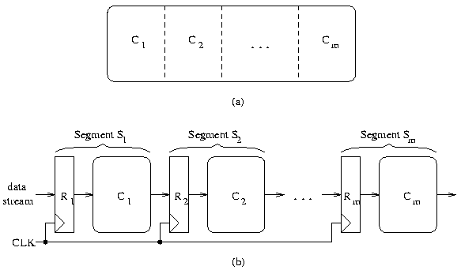
Pipeline Processing: Basic Structure
Data in
Data out

Slide 15
Pipeline Processing: Basic Structure
A pipeline processor consists of a sequence of m data-processing circuits, called stages or segments, which collectively perform a single operation on a stream of data operands passing through them.
Some processing takes place in each stage, but a final result is obtained only after an operand set has passed through the entire pipeline.
As illustrated in Fig (b), a stage S_{i} contains a multi-word input register or latch R_{i}, and a datapath circuit C_{i} that is usually combinational.
The R_{i}’s hold partially processed results as they move through the pipeline; they also serve as buffers that prevent neighboring stage from interfering with one another.
A common clock signal causes the R_{i}’s to change state synchronously.

Slide 16
Pipeline Processing: Basic Structure
Each R_{i} receives a new set of input data D_{i – 1}from the preceding stage S_{i – 1} except for R1 whose data is supplied from an external source.
D_{i – 1}represents the results computed by C_{i- 1}during the preceding clock period.
Once D_{i – 1}has been loaded into R_{i}, C_{i} proceeds to use D_{i - 1} to compute a new data set D_{i}.
Thus in each clock period, every stage transfers its previous results to the next stage and computes a new set of results.

Slide 17
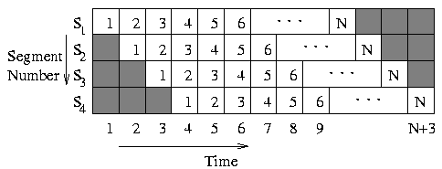
Pipeline Processing: Basic Structure
Speedup
  Speedup(pipeline) = Time(no pipeline) / Time (pipeline)
Space-Time Diagram
Efficiency
  Ratio of “numbered blocks” to total number of space-time blocks
  What is the efficiency of an ideal m-stage pipeline operating on N data items?

Slide 18
That’s All
Thank You

